Slide 2
My Journey
A story of what I learned
Of Web Development in Spring 2023

Slide 3
My Journey
Is a story of what I learned
HTML, CSS, JavaScript, Jquery, BootStrap
Building a Webpage
Site shows work done during the course
About Me Page
Brasilian Restaurant Page

Slide 4
Stakeholders & Audience
Stakeholders
Government, Employers, and Me
Affected by getting an employee
I’m affected by getting employment
Audience
Employers and Curious Individuals
Those who are interested visit the site

Slide 5
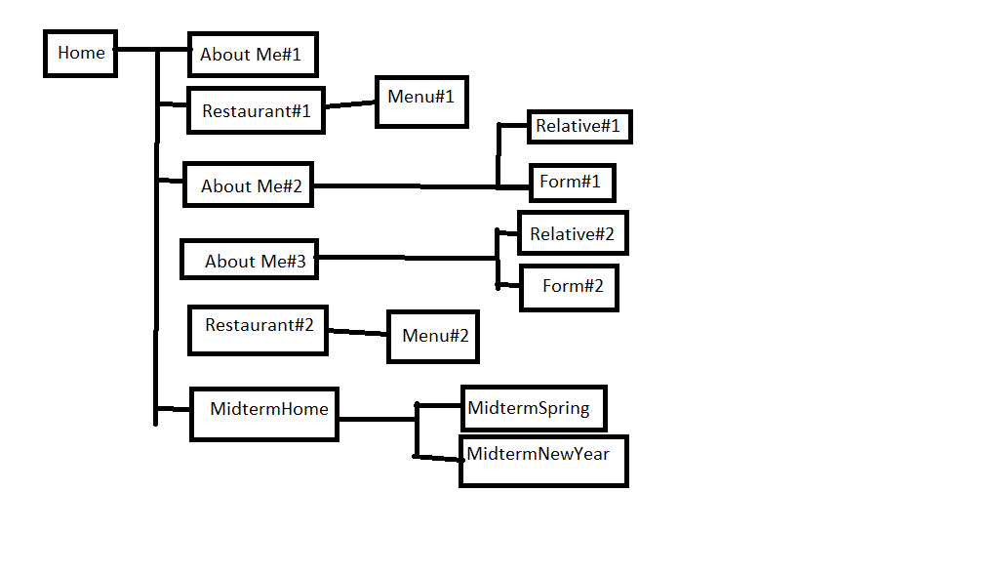
Sitemap
Shows how the site is organized
Helps for structure to the site.

Slide 6
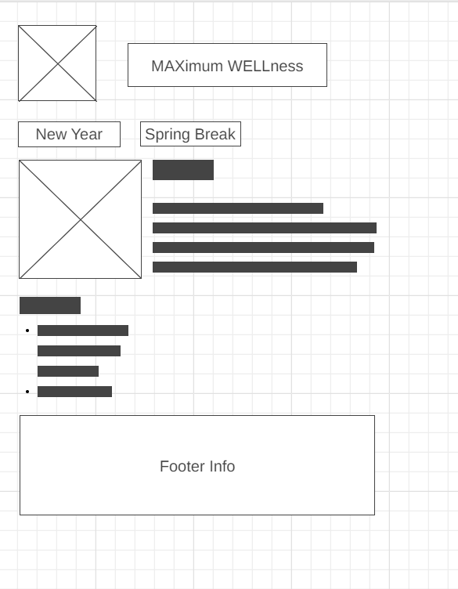
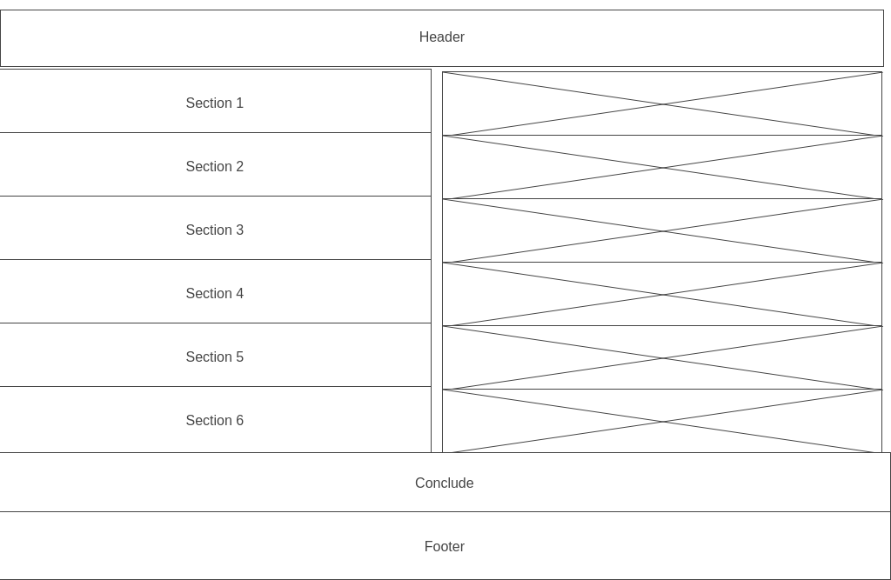
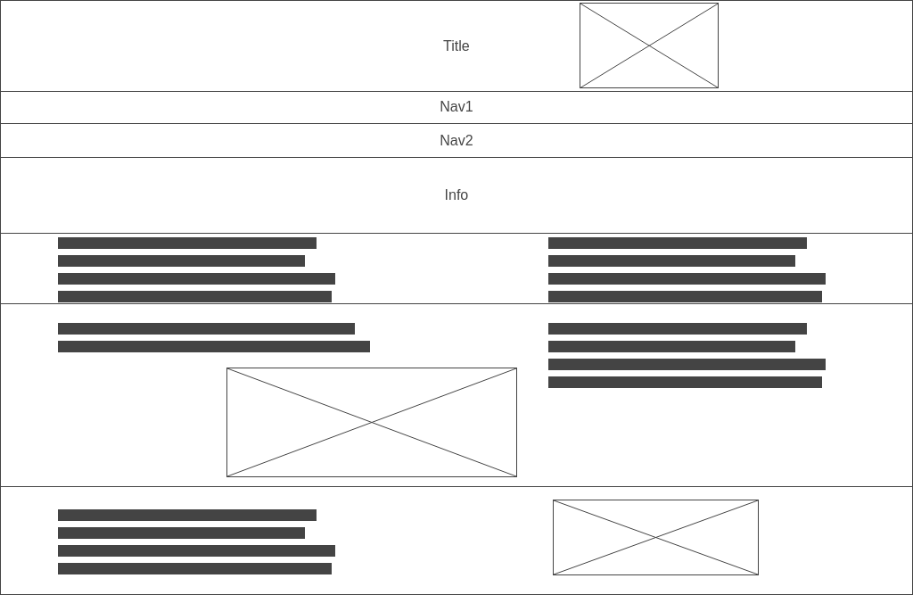
Wireframe
Rough guide for building webpage
Format of how site will look
Only a few will be shown

Slide 7
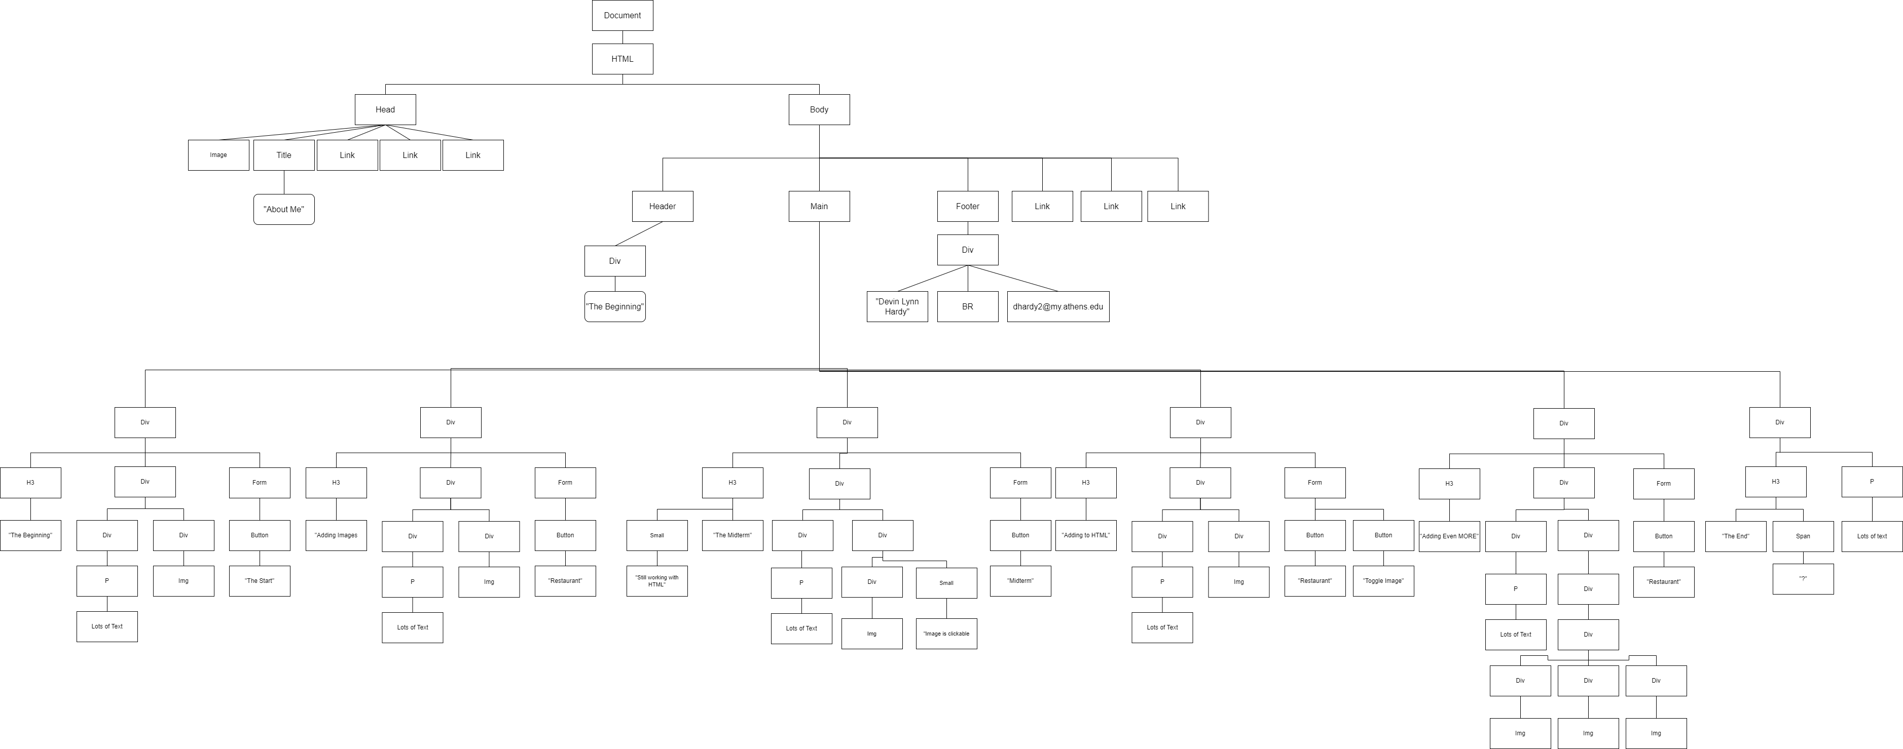
DOM
Model of the html code
Structured Model of

Slide 8
Validation
Site Validation:
Every page has been validated
Green for all pages
Accessibility:
Pages are accessible
Some Alerts
Mobile friendly:
Site is not mobile friendly
Could be enhanced to fix that

Slide 9
Live Demo
Pause Presentation for Live Demo

Slide 10
Reflection
I struggled being creative
CSS, and JavaScript was difficult
But I enjoyed the structure
HTML and BootStrap was fun

